Slide 1
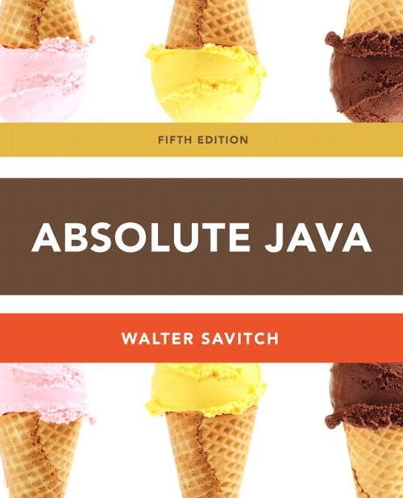
Chapter 4
Class Definitions
Section 4.1
Slides prepared by Rose Williams, Binghamton University
Kenrick Mock, University of Alaska Anchorage

Slide 2
Introduction
Classes are the most important language feature that make object-oriented programming (OOP) possible
Programming in Java consists of defining a number of classes
Every program is a class
All helping software consists of classes
All programmer-defined types are classes
Classes are central to Java

Slide 3
Class Definitions
You already know how to use classes and the objects created from them, and how to invoke their methods
For example, you have already been using the predefined String and Scanner classes
Now you will learn how to define your own classes and their methods, and how to create your own objects from them

Slide 4
A Class Is a Type
A class is a special kind of programmer-defined type, and variables can be declared of a class type
A value of a class type is called an object or an instance of the class
If A is a class, then the phrases “employee is of type A," “employee is an object of the class A," and “employee is an instance of the class A" mean the same thing
A class determines the types of data that an object can contain, as well as the actions it can perform

Slide 5
Primitive Type Values vs. Class Type Values
A primitive type value is a single piece of data
A class type value or object can have multiple pieces of data, as well as actions called methods
All objects of a class have the same methods
All objects of a class have the same pieces of data (i.e., employee record - name, address, job title, and salary)
For a given object, each piece of data can hold a different value

Slide 6
The Contents of a Class Definition
A class definition specifies the data items and methods that all of its objects will have
These data items and methods are sometimes called members of the object
Data items (i.e., name, address, job title, salary) are called fields or instance variables
Instance variable declarations and method definitions can be placed in any order within the class definition

Slide 7
The new Operator
An object of a class is named or declared by a variable of the class type:
ClassName classVar;
The new operator must then be used to create the object and associate it with its variable name:
classVar = new ClassName();
These can be combined as follows:
ClassName classVar = new ClassName();

Slide 8
Instance Variables and Methods
Instance variables can be defined as in the following two examples
Note the public modifier (for now):
public String instanceVar1;
public int instanceVar2;
In order to refer to a particular instance variable, preface it with its object name as follows:
objectName.instanceVar1
objectName.instanceVar2

Slide 9
Instance Variables and Methods
Method definitions are divided into two parts: a heading and a method body:
public void myMethod() { Heading
code to perform some action
and/or compute a value Body
}
Methods are invoked using the name of the calling object and the method name as follows:
classVar.myMethod();
Invoking a method is equivalent to executing the method body

Slide 10
File Names and Locations
Reminder: a Java file must be given the same name as the class it contains with an added .java at the end
For example, a class named MyClass must be in a file named MyClass.java
Your program and all the classes it uses should be in the same directory or folder

Slide 11
More About Methods
There are two kinds of methods:
Methods that compute and/or perform an action and returns a value
Methods that perform an action
This type of method does not return a value, and is called a void method
Each type of method differs slightly in how it is defined as well as how it is (usually) invoked

Slide 12
More About Methods
A method that returns a value must specify the type of that value in its heading:
public typeReturned methodName(paramList)
A void method uses the keyword void in its heading to show that it does not return a value :
public void methodName(paramList)

Slide 13
main is a void Method
A program in Java is just a class that has a main method
When you give a command to run a Java program, the run-time system invokes the method main
Note that main is a void method, as indicated by its heading:
public static void main(String[] args)

Slide 14
return Statements
The body of both types of methods contains a list of declarations and statements enclosed in a pair of braces
public <void or typeReturned> myMethod(){
declarations
statements B
}
ody

Slide 15
return Statements
The body of a method that returns a value must also contain one or more return statements
A return statement specifies the value returned and ends the method invocation:
return Expression;
Expression can be any expression that evaluates to something of the type returned listed in the method heading

Slide 16
return Statements
A void method need not contain a return statement, unless there is a situation that requires the method to end before all its code is executed
In this context, since it does not return a value, a return statement is used without an expression:
return;

Slide 17
Method Definitions
An invocation of a method that returns a value can be used as an expression anyplace that a value of the typeReturned can be used:
typeReturned tRVariable;
tRVariable = objectName.methodName();
An invocation of a void method is simply a statement:
objectName.methodName();

Slide 18
Any Method Can Be Used As a void Method
A method that returns a value can also perform an action
If you want the action performed, but do not need the returned value, you can invoke the method as if it were a void method, and the returned value will be discarded:
objectName.returnedValueMethod();

Slide 19
Local Variables
A variable declared within a method definition is called a local variable
All variables declared in the main method are local variables
All method parameters are local variables
If two methods each have a local variable of the same name, they are still two entirely different variables

Slide 20
Global Variables
Some programming languages include another kind of variable called a global variable
The Java language does not have global variables

Slide 21
Blocks
A block is another name for a compound statement, that is, a set of Java statements enclosed in braces,{}
A variable declared within a block is local to that block, and cannot be used outside the block
Once a variable has been declared within a block, its name cannot be used for anything else within the same method definition

Slide 22
BankAccount.java
1 /**
2 A bank account has a balance that can be changed by
3 deposits and withdrawals.
4 */
5 public class BankAccount {
6
7 private double balance;
8
9 /**
10 Constructs a bank account with a zero balance.
11 */
12 public BankAccount() {
13
14 balance = 0;
15 }
16
17 /**
18 Deposits money into the bank account.
19 @param amount the amount to deposit
20 */
21 public void deposit(double amount) {
22
23 balance = balance + amount;
24 } (Continued)

Slide 23
25
26 /**
27 Withdraws money from the bank account.
28 @param amount the amount to withdraw
29 */
30 public void withdraw(double amount) {
31
32 balance = balance - amount;
33 }
34
35 /**
36 Gets the current balance of the bank account.
37 @return the current balance
38 */
39 public double getBalance() {
40
41 return balance;
42 }
43
(Continued)

Slide 24
44 /**
45 Determines and returns the cost of a safe deposit box.
46 @param size the size of the safe deposit box
47 @return the cost of the save deposit
48 */
49 public double getSafeDepositBoxCost(String size) {
50
51 double cost = 0;
52 if (size.equals(“small”))
53 cost = 5.95;
54 else if (size.equals(“medium”))
55 cost = 7.95;
56 else if (size.equals(“large”))
57 cost = 12.95;
58 else
59 System.out.println(“Invalid size”);
60
61 return cost;
62 }
}

Slide 25
Testing the BankAccount class
1 /**
2 A class to test the BankAccount class.
3 */
4 public class BankAccountTester {
5
6 public static void main(String[] args) {
7
8 BankAccount harrysChecking = new BankAccount();
9 harrysChecking.deposit(2000);
10 harrysChecking.withdraw(500);
11 System.out.printf(“Balance = $%.2f”,
12 harrysChecking.getBalance());
13 cost = getSafeDepositBoxCost(“small”);
14 System.out.printf(“Safe Deposit Box Cost = $%.2f“, cost);
15 }
16 }
Program Run:
Balance = $1500.00
Safe Deposit Box Cost = $5.95

Slide 26
Parameters of a Primitive Type
Some methods need to receive additional data via a list of parameters in order to perform their work, these parameters are also called formal parameters
A parameter list provides a description of the data required by a method
It indicates the number and types of data pieces needed, the order in which they must be given, and the local name for these pieces as used in the method
public double myMethod(int p1, int p2, double p3)

Slide 27
Parameters of a Primitive Type
When a method is invoked, the appropriate values must be passed to the method in the form of arguments
Arguments are also called actual parameters
The number and order of the arguments must exactly match that of the parameter list
The type of each argument must be compatible with the type of the corresponding parameter
int a=1,b=2,c=3;
double result = myMethod(a,b,c);

Slide 28
Parameters of a Primitive Type
In the preceding example, the value of each argument (not the variable name) is plugged into the corresponding method parameter
This method of plugging in arguments for formal parameters is known as the call-by-value mechanism

Slide 29
Parameters of a Primitive Type
If argument and parameter types do not match exactly, Java will attempt to make an automatic type conversion
In the preceding example, the int value of argument c would be cast to a double
A primitive argument can be automatically type cast from any of the following types, to any of the types that appear to its right:
byte→short→int→long→float→double
char

Slide 30
Parameters of a Primitive Type
A parameters is often thought of as a blank or placeholder that is filled in by the value of its corresponding argument
However, a parameter is more than that: it is actually a local variable
When a method is invoked, the value of its argument is computed, and the corresponding parameter (i.e., local variable) is initialized to this value
Even if the value of a formal parameter is changed within a method (i.e., it is used as a local variable) the value of the argument cannot be changed

Slide 31
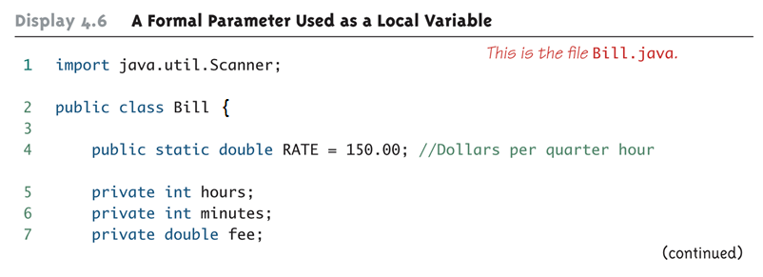
A Formal Parameter Used as a Local Variable (Part 1 of 5)

Slide 32
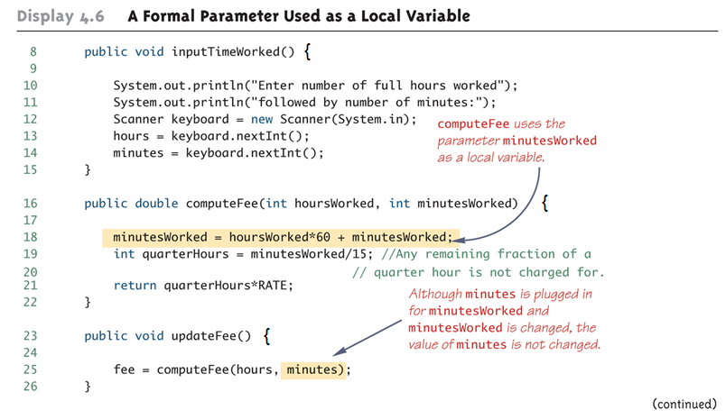
A Formal Parameter Used as a Local Variable (Part 2 of 5)

Slide 33
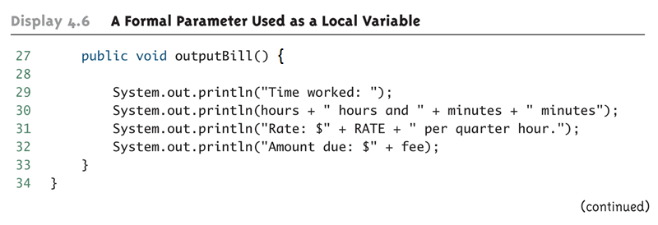
A Formal Parameter Used as a Local Variable (Part 3 of 5)

Slide 34
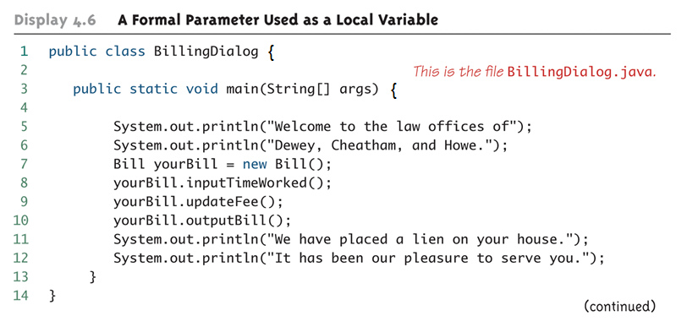
A Formal Parameter Used as a Local Variable (Part 4 of 5)

Slide 35
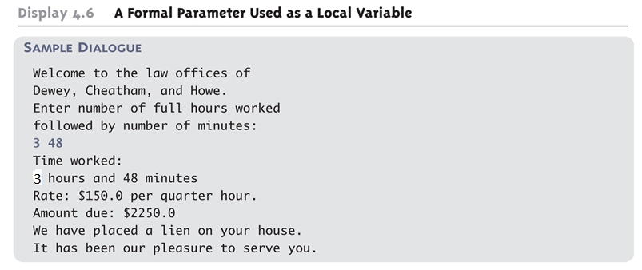
A Formal Parameter Used as a Local Variable (Part 5 of 5)

Slide 36
The this Parameter
All instance variables are understood to have <the calling object>. in front of them
If an explicit name for the calling object is needed, the keyword this can be used
myInstanceVariable always means and is always interchangeable with this.myInstanceVariable

Slide 37
The this Parameter
this must be used if a parameter or other local variable with the same name is used in the method
Otherwise, all instances of the variable name will be interpreted as local
public void withdraw(double balance) {
this.balance = this.balance - balance;
}

Slide 38
The methods equals and toString
Java expects certain methods, such as equals and toString, to be in all, or almost all, classes
The purpose of equals, a boolean valued method, is to compare two objects of the class to see if they satisfy the notion of "being equal“
Note: You cannot use == to compare objects
public boolean equals(ClassName objectName)
The purpose of the toString method is to return a String value that represents the data in the object
public String toString()

Slide 39
Testing Methods
Each method should be tested in a program in which it is the only untested program
A program whose only purpose is to test a method is called a driver program
One method often invokes other methods, so one way to do this is to first test all the methods invoked by that method, and then test the method itself
This is called bottom-up testing
Sometimes it is necessary to test a method before another method it depends on is finished or tested
In this case, use a simplified version of the method, called a stub, to return a value for testing

Slide 40
The Fundamental Rule for Testing Methods
Every method should be tested in a program in which every other method in the testing program has already been fully tested and debugged

